Slide 1
Programming Paradigms
“Computer Science is no more about computers than astronomy is about telescopes.”
- Edsger Dijkstra
CS 3022 – Types
Notes:
Many of these slides were adapted from a course given by Stephen Schulz.

Slide 2

Abstraction – driving a car example
What do you need to know to drive a car?

Slide 3
What are High-Level Languages?
“High-level” = greater abstraction. language features hide machine-specific details of any given architecture.
This separation lets programs express ideas in terms of variables, control structures, and data types rather than registers and instructions.

Slide 4
Early Design Goals
Early Goals (Fortran, Algol, Lisp):
Machine independence → “a programming language should not rely on the features of any particular instruction set for its efficient implementation”
vs.
Ease of programming → More elusive, compelling goal. Drives modern design.

Slide 5

Abstraction – definition #2?
Per the book: “A process by which the programmer associates a name with a potentially complicated program fragment”
What is a name?

Slide 6
Subroutines vs. Classes
Subroutines (Control Abstraction)
Hide complex code behind a simple interface
Emphasize behavior (what, not how)
Classes (Data Abstraction)
Hide data representation details
Emphasize structure & operations (interact, not internal form)

Slide 7
Binding
Binding - an association between two things, such as a name and the thing it names.
Binding time - the time at which a binding is created.
When was your bind time as a human? What is the optimal time to bind a human? What about a ship?
Other interesting bind time examples?

Slide 8
The Seven Stages of Bind Time:
Language Design Time - Fundamental language features
Language Implementation Time - Implementation-specific decisions
Program Writing Time - Programmer choices
Compile Time - Translation to machine code
Link Time - Module integration and resolution
Load Time - Program loading into memory
Run Time - Dynamic execution decisions

Slide 9
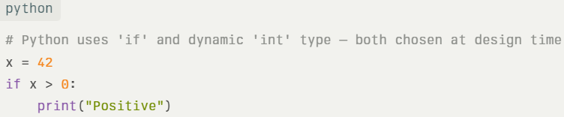
Language design time
Decisions baked into the language spec: control‐flow keywords, primitive types, typeconstructors.
Fixed for all programs written in the language.

Slide 10
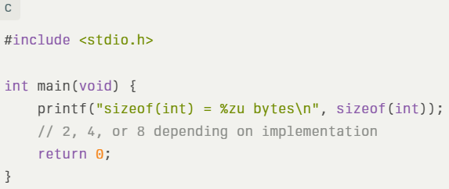
Language implementation time
Details set by a compiler/runtime vendor: size of int, stack layout, I/O integration, overflowbehavior.
Varies between implementations of the same language.

Slide 11
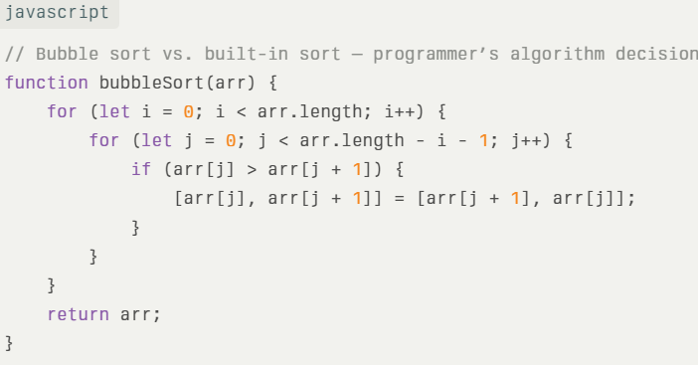
Program writing time
Choices made by the programmer: algorithms, data structures, identifier names.
Finalized in source before compilation.

Slide 12
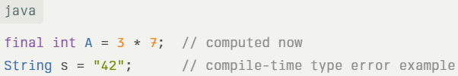
Compile time
Compiler maps high-level constructs to machine code & lays out static data.
Errors caught here prevent later failures.

Slide 13
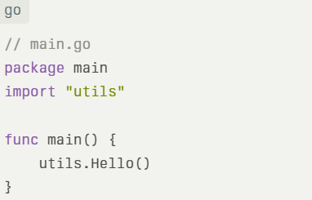
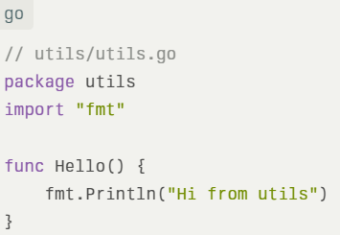
Link Time
Linker combines object files & libraries; resolves cross-module references.
Determines final virtual addresses of symbols.

Slide 14
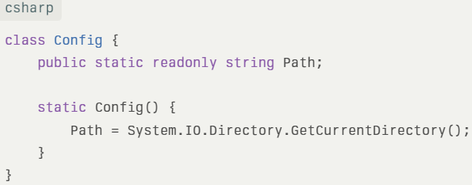
Load time
Loader/OS places the executable in memory; static initializers run.
May relocate addresses to physical memory.

Slide 15
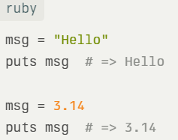
Run time
Everything between main entry and program exit: variable bindings, dynamic dispatch, I/O, Garbage Collection.

Slide 16
Static vs. Dynamic Binding
Static → Bound before run time (compile time)
Dynamic → Bound at run time
Terms are coarse but useful distinctions

Slide 17

Bind time trade-off
← Early Binding
Late Binding →
Efficiency, Safety
C, C++
Rust
Flexibility, Ease of use
PHP Javascript
Python

Slide 18
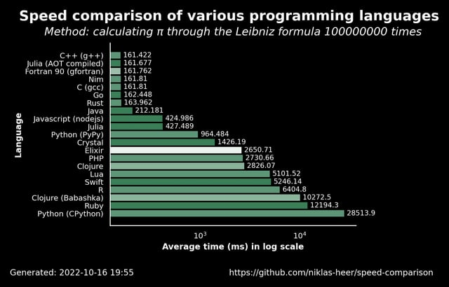
Speed comparison

